Slide 1
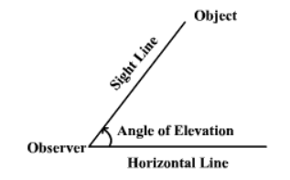
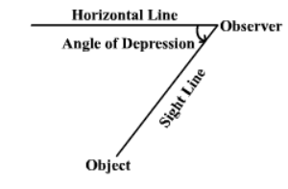
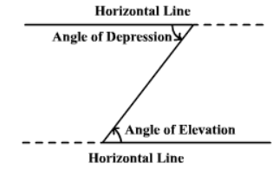
ANGLES OF ELEVATION AND DEPRESSION
Angles of Elevation
The term angle of elevation denotes the angle from the horizontal upward to an object. an observer’s line of sight would be above the horizontal.
Angles of Depression
the term angle of depression denotes the angle from the horizontal downward to an object. an observer’s line of sight would be below the horizontal.
Note that the angle of elevation and the angle of depression are congruent .i.e. are equal

Slide 2
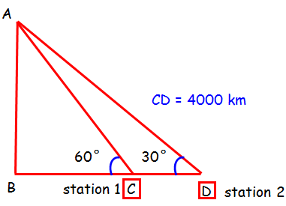
Example 1
The angles of elevation of an artificial earth satellite is measured from two earth stations, situated on the same side of the satellite, are found to be 30° and 60°. The two earth stations and the satellite are in the same vertical plane. If the distance between the earth stations is 4000 km, find the distance between the satellite and earth. (to the nearest whole number)
SOLUTION
tan θ = opposite side/Adjacent side
tan 60º = $\frac{\text{AB}}{\text{B}C}$ , AB = tan 60º x BC =1.7321 x BC ……(.i)
tan 30º = $\frac{\text{AB}}{\text{B}C+4000}$ , AB = tan 30º ( BC + 4000) = 0.5774 ( BC + 4000)=2309.6 +0.5774BC…(ii)
equating the 2 equations
1.7321BC = 2309.6 +0.5774BC
1.7321BC - 0.5774BC = 2309.6 , 1.1547BC = 2309.6 , BC = $\frac{\text{2309.6}}{\text{1.1547}}$ = 2000.1732 = 2000km
AB = distance of satellite to earth
= 1.7321BC = 1.7321 x 2000.1732 = 3465km (nearest whole number)

Slide 3
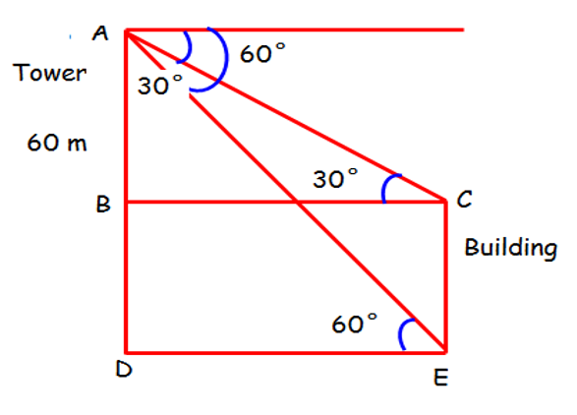
EXAMPLE 2
From the top of a tower of height 60 m, the angles of depression of the top and the bottom of a building are observed to be 30° and 60° respectively. Find the height of the building
SOLUTION
the required distance is BD
let AB = x and BC = y
tan 60º = $\frac{\text{60}}{\text{y}}$ , y = $\frac{\text{60}}{\text{tan}\text{ 60}\text{o}}$ = 34.64km
tan 30º = $\frac{\text{x}}{\text{34.64}}$ , x = 34.64 tan 30º = 19.999 =20km
building height = BD = 60 – 20 = 40km

Slide 4
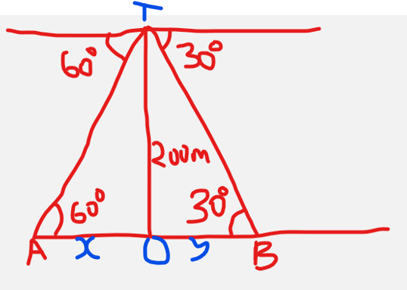
EXAMPLE 3
From the top of a cliff 200 m height, the angles of depression of two places A and B on the ground and on the opposite sides of the cliff are 60° and 30°. Find the distance between A and B.
Solution
distance AB = x +y
tan 60º = $\frac{\text{200}}{\text{x}}$ , x = $\frac{\text{200}}{\text{tan}\text{ 60}\text{o}}$ = 115.47m
tan 30º = $\frac{\text{200}}{\text{y}}$ , y = tan 30º = $\frac{\text{200}}{\text{tan}\text{ 30}\text{o}}$ = 346.41m
distance AB = 115.47m + 346.41m = 461.88 m
+

Slide 5
END
REMEMBER TO SUBSCRIBE FOR ME
MWALIMU OGEKE

